Slide 1

constructing a mortality dashboard
Richard Wilson
Director – i7
Richard@i7analytics.co.uk
@wilson9_richard
Find it and follow along here
https://github.com/richardi7/SHMI_dashboard
Rpubs link

Slide 2
Aims of talk
Why do we need another dashboard?
Options
Excel
Tableau (and or Qlik PowerBI…)
R – Flexdashboard
Building the dashboard
Learning points

Slide 3
My journey to using R
A non-linear path to R, and my approach to delivering this dashboard is the result of my own programming journey:
1st computer ZX80 with 16k expansion pack (BASIC)
O-level computing in BASIC on an Acorn
MSc IT and manufacturing: C++, UNIX
PhD using VMS/VAX PASCAL analysing Hospital Episode Statistics
1st website 1994 REGINET (html)
SQL SERVER data warehouse for HES on DEC alpha Windows NT
Into NHS and EXCEL!
R for 9 months

Slide 4

Why mortality?
Hospital mortality was brought into stark focus by the Mid Staffs Enquiry
“This new (SHMI) measure will help ensure patient safety by acting like a smoke alarm to prompt further investigation. Alongside other data, this will help the NHS in future to spot and act on poor care as soon as possible.”
Patients and families are rightly concerned about them … we all should be!
Giving an accurate and balanced message to local partners, regulators, and the public is vital therefore you need to understand your data
Even the best hospitals will have some ‘excess’ deaths
Area where trusts ‘buy-in’ services (DFI/HED, i7..) when they could do pretty much everything themselves as most of the data for SHMI is freely available
Many trusts do too little or too much
Also interesting indicator for data science world as it is the largest, longest running algorithm (logistic regression) in NHS

Slide 5
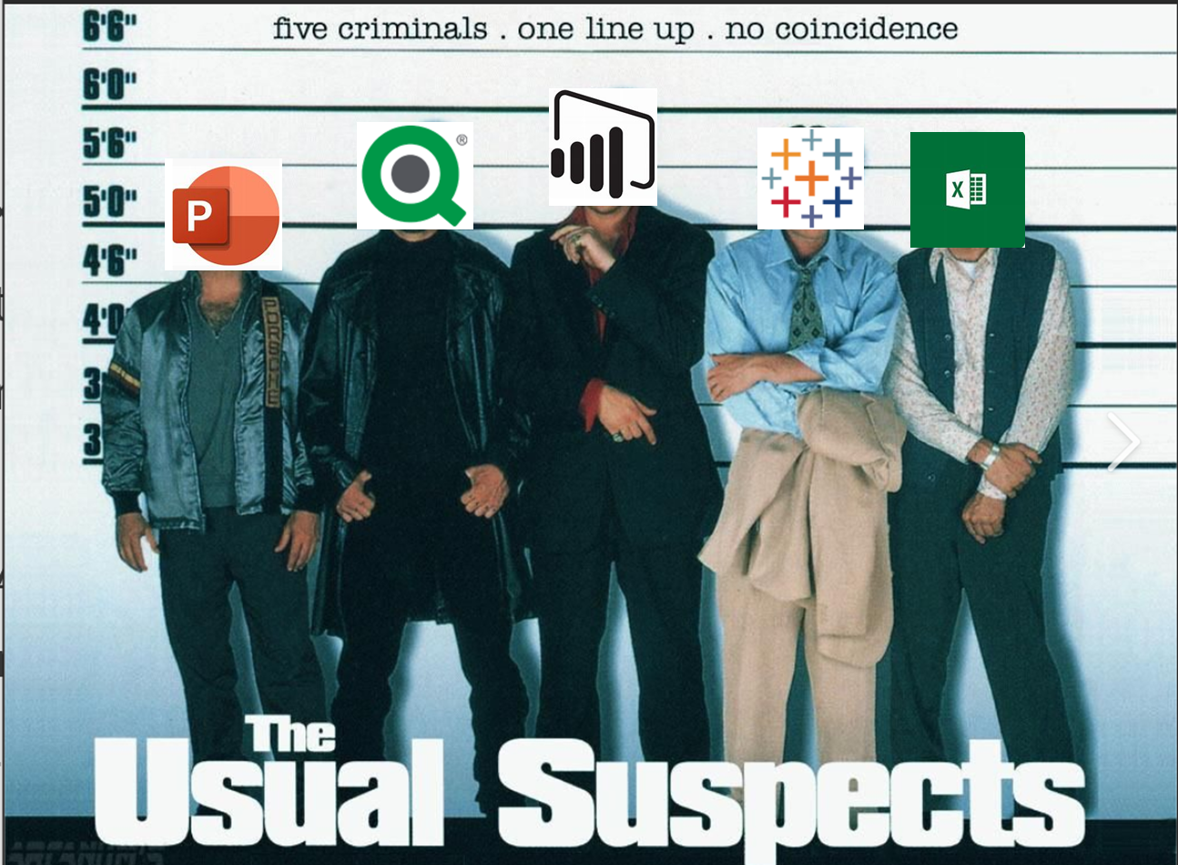
Dashboard solutions

Slide 6
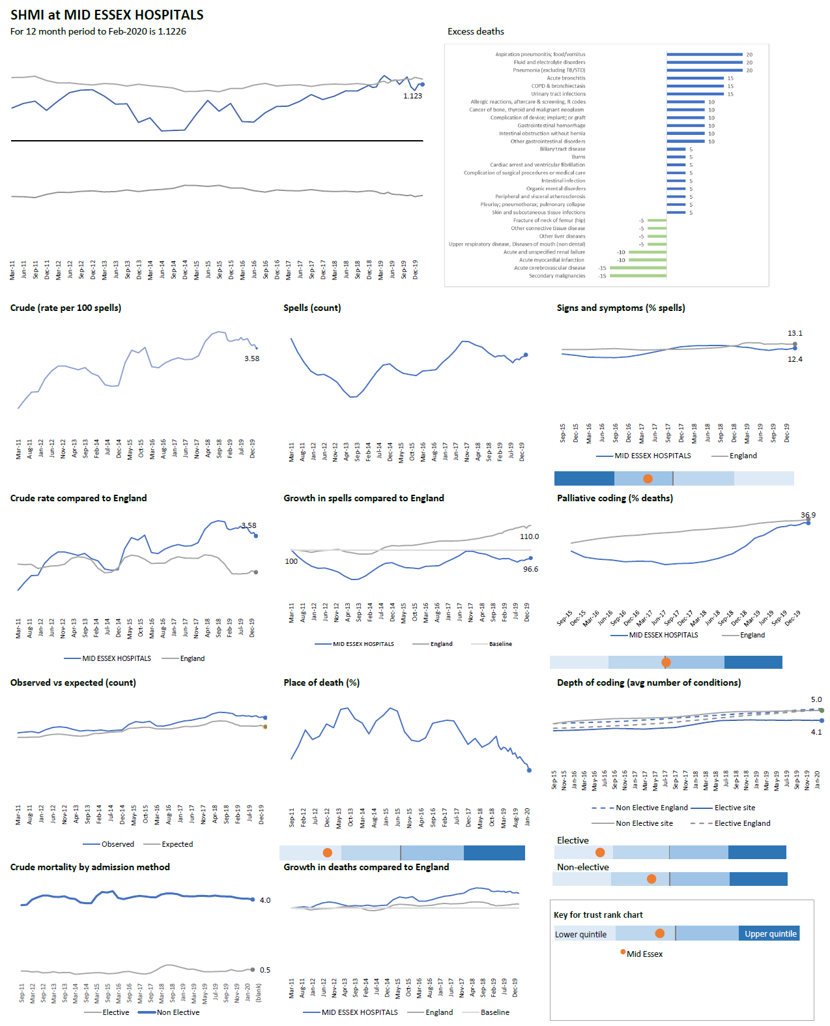
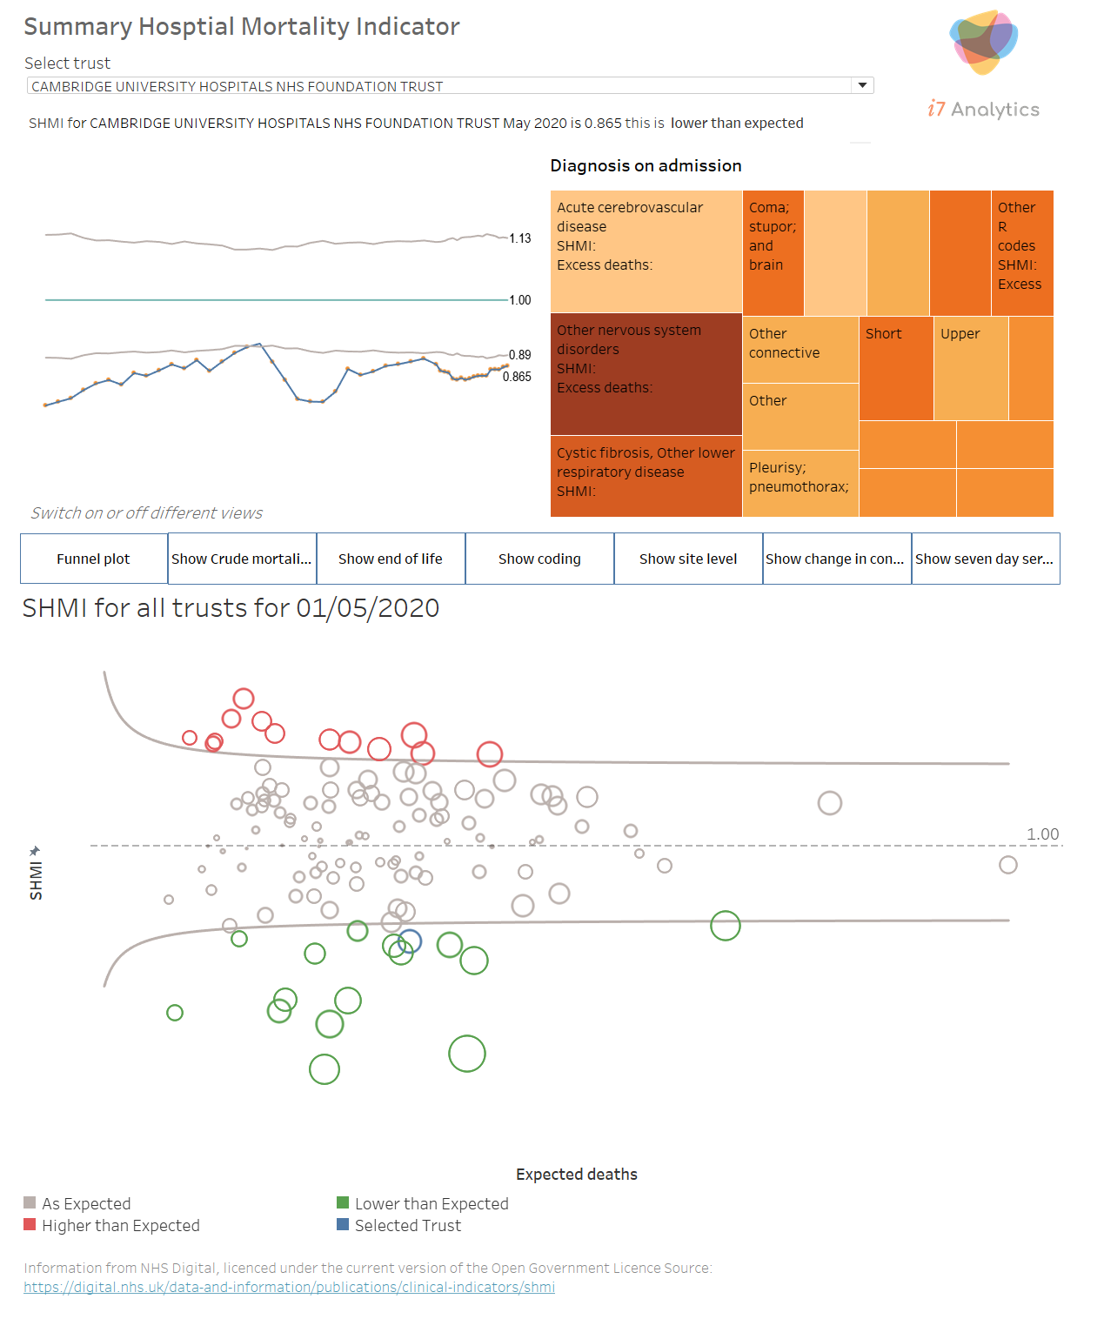
Usual suspects
Excel
Tableau

Slide 7
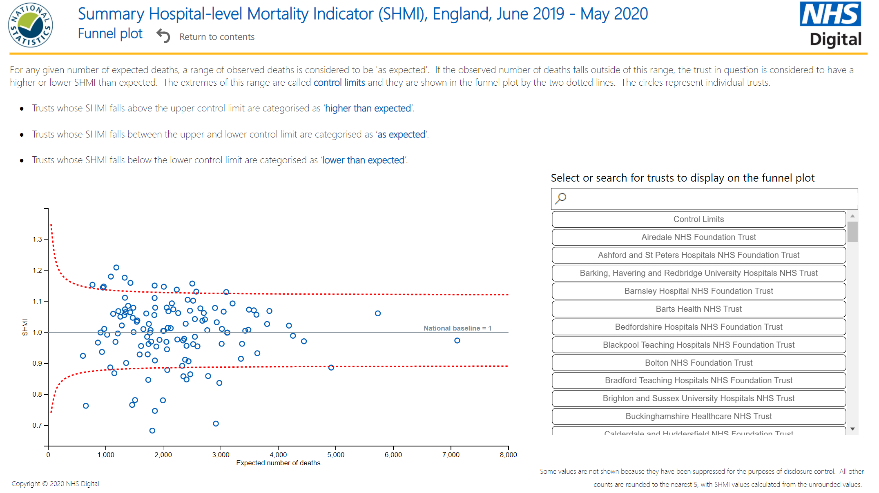
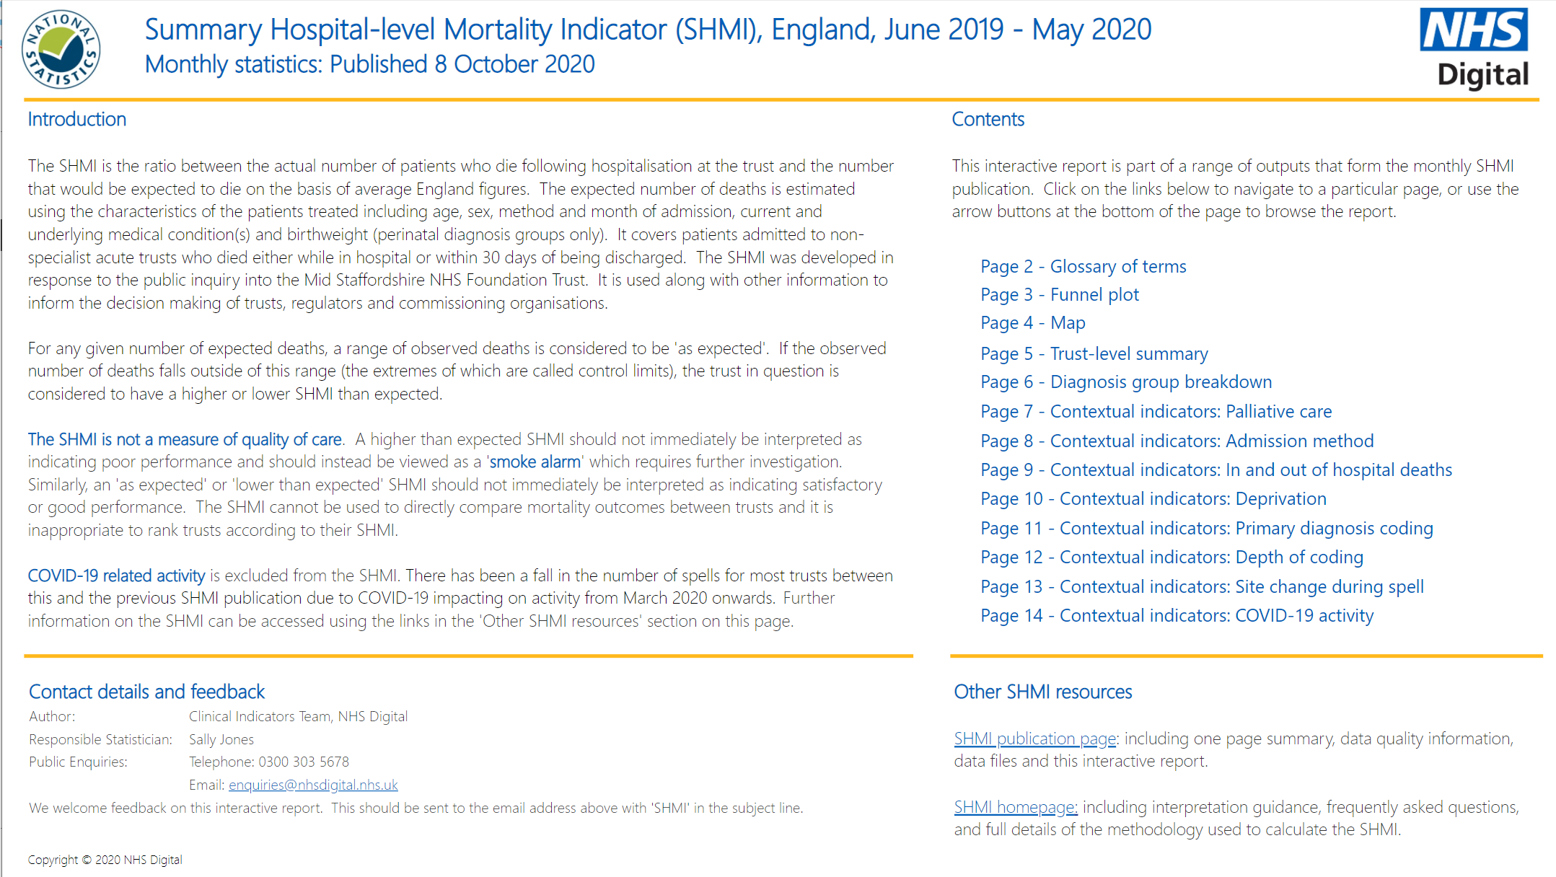

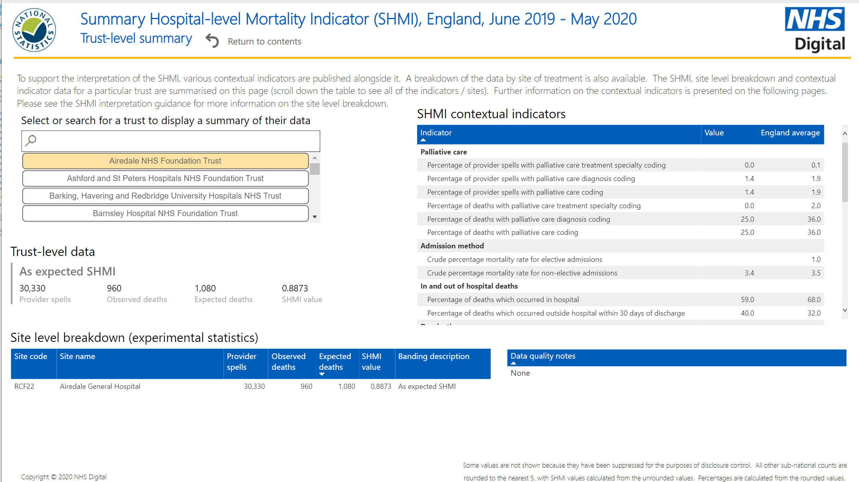
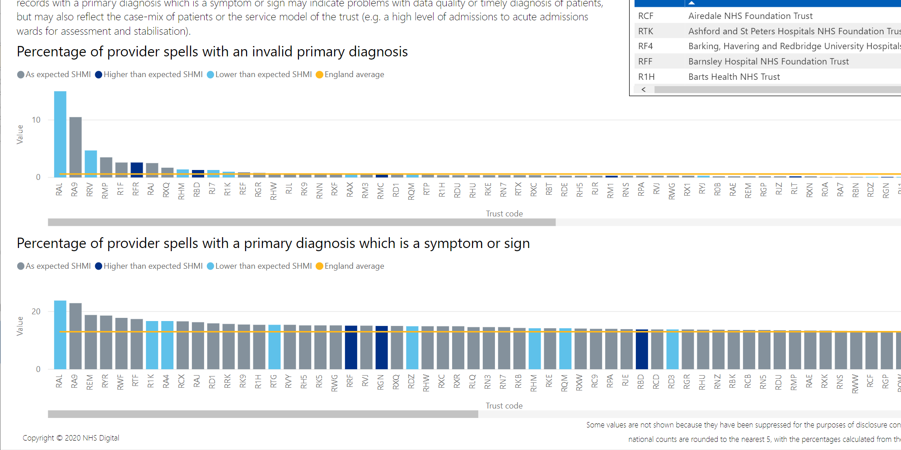
Powerbi: nhs digital

Slide 8
Excel
Pros
Cons
Ubiquitous
Everyone ‘knows’ how to use it
Ideal for scrapbooking ideas
Fast
Cheap
V flexible
Easy to make complicated standard graphs – paint it numbers
Paper-ready formats
Cut and paste
…
Different versions have different graphing options
Little interactivity
No ‘on chart’ filtering
No tooltips
Huge files
Easy to corrupt
Lack of version control
Difficult to update/automate
Difficult to mass produce
…

Slide 9
Tableau (or other visualisation package)
Pros
Cons
Glorious graphics
Desk top publishing quality
Drag and drop
Pixel perfect
Interactive
Automation
Mapping
Shareable workbooks
Support
Mobile ready formats
Digital first
Additional cost
Need server and/or viewer licences
New skills
Data wrangling
Not print friendly
Not transferable between packages
Black box – what you get is what you get

Slide 10
R
Pros
Cons

Slide 11
WHY flexdashboard?
Being honest, been using Markdown and was trying different options and thought give it a go
Could I replicate my Tableau dashboard in R

Slide 12
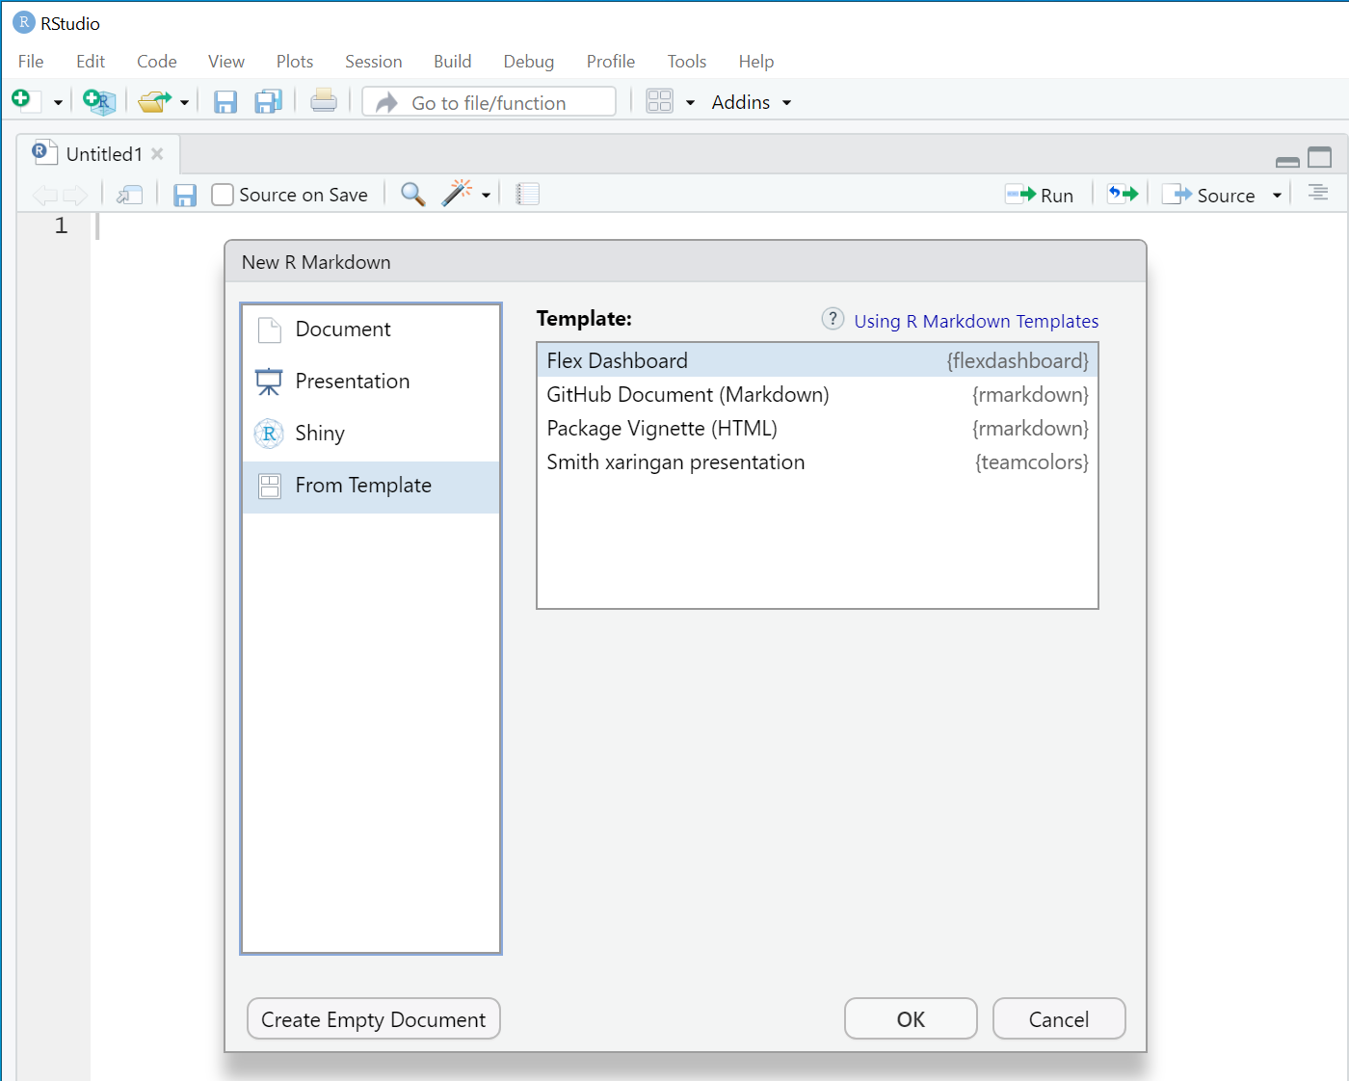
FLexdashboard
Uses R Markdown to publish a group of related data visualisations as a dashboard
A flexdashboard can either be static (a standard web page) or dynamic (a Shiny interactive document). A wide variety of components can be included in flexdashboard layouts, including:
Interactive JavaScript data visualizations based on htmlwidgets.
R graphical output including base, lattice, and grid graphics.
Tabular data (with optional sorting, filtering, and paging).
Value boxes for highlighting important summary data.
Gauges for displaying values on a meter within a specified range.
Text annotations of various kinds.

Slide 13
Building the dashboard

Slide 14
6 step plan - Creating a dashboard
Determine purpose and audience
Plan the dashboard using design best practices
Build
Test it
Deploy
Maintain and iterate

Slide 15
1 - Purpose and audience
Purpose
High level view of available data focusing on key measures related to SHMI
Not looking for lots of interactivity as this is an explanatory not exploratory dashboard
Who is my user?
Aimed at mortality leads: Board members, Medical Directors or their Deputies, some understanding of the measures, wants quick summary, see what has changed, who need guided explanation
Picture on a page
Only one trust per dashboard
Not for analysts or clinicians who need to explore why their service is different
Another flexdashboard for clinical leads that is more granular

Slide 16
2 - Planning the dashboard
Content
NHS Digital data files for SHMI
Defined measures
Monthly updates

Slide 17
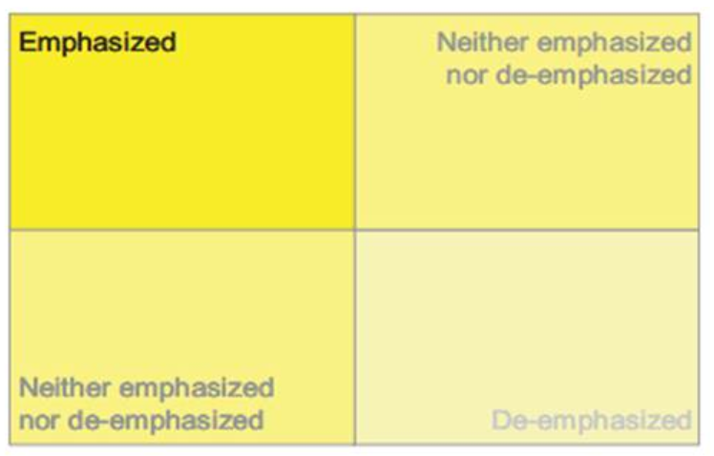
Design - F shape layout
One of the biggest things to keep in mind while laying out your dashboard is how we as humans generally view dashboards (or at least those who read left to right)
Most of the time we will view the top left first then work across horizontally before going back to left hand side of the page but a bit lower
After scrolling to the right we stop at the middle and go back to left side
We track in a F shaped fashion
So most important goes in top left and least important in bottom right
Image Source: Stephen Few, With Dashboards Formatting & Layout Definitely Matter

Slide 18
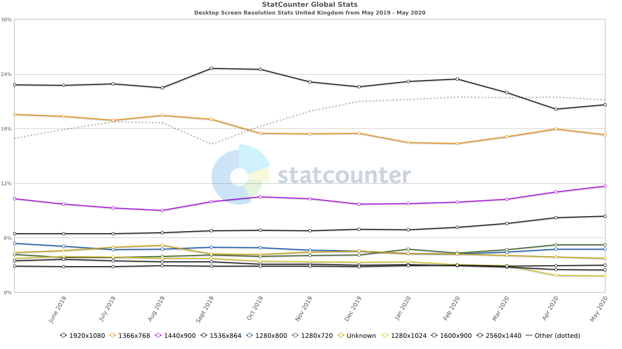
Design – Orientation and size
Vertical or horizontal
Paper or digital first
Most popular is rectangular landscape view (digital focus)
Vertical (portrait) is popular in Tableau as it mirrors the idea of a newspaper/report
Vertical aligns to board reporting without having to turn it 90 degrees
Common browsers are (width * height):
1920×1080 – 20.62%
1366×768 – 17.32%
1440×900 – 11.65%
1536×864 – 8.38%
1280×720 – 5.2%
A4 paper (portrait) 2481(w) * 3507 (h) @300 dpi
Set dashboard at 1000x800
Height is more important than width
Fits inside a screen
Aim is to keep all the information in line-of-sight NO scrolling
1920*1082
1366*768
1440*900
https://www.hobo-web.co.uk/best-screen-size/

Slide 19
3 – Build: Workflow
NHS D monthly zip archive
Tableau
.public
.CSV
Add new data to timeline (R)
Flexdashboard
.html
Historical data in RDS format
.RDS
Functions.R
.RDS

Slide 20

Meta development
Analysis repository
YAML
library(..)
source(../functions.R)
data<-shmi.RDS
data wrangling
viz_text(data)
table_fx(data)
viz_fx(data)
fixed_text
 | /analysis: final reports
 | /src: scripts
 | /output: data artifacts
 | /data: raw source data
 | /doc: documentation
 | /ext: external files
https://emilyriederer.netlify.app/post/rmarkdown-driven-development/

Slide 21
Markdown

Slide 22

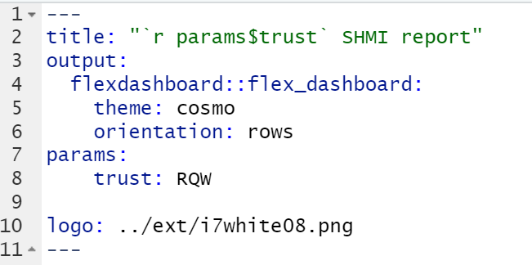




YAML
Title repeats on every page
Theme in this case cosmo (which is actually the default) and is similar to NHS house style
Orientation
Column or row
You can embed columns in rows and rows in columns
Parameters used to select content (trust)
Logo, you can include image in title bar
Not vector image and fixed size and will go pixelated

Slide 23
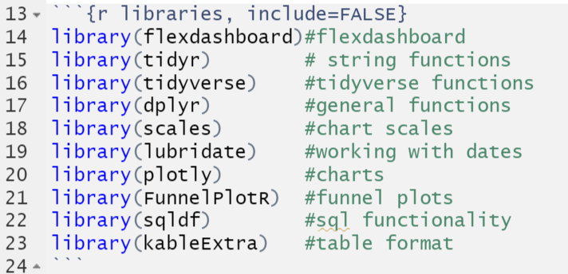
Libraries
Bit of a magpie when it comes to libraries
Also like to use things I know that work hence sqldf
Used for grouping and ordering data
Data
Two data files
Split required to reduce data frame size
Use .rds
faster to restore the data to R
keeps R specific information encoded in the data (e.g., attributes, variable types, etc).

Slide 24
Data Wrangling
Much of the code is fixing the vagaries in the dataset ready for charting
Introduction of new variables across years
Missing data, data not available for all years or for every trust
Reducing content by excluding small numbers
Making variable names ‘user friendly’ for ggplot labels
Pivoting data to match requirements for charts:
in either long or wide format
whole reporting period or latest month

Slide 25
Wireframes & the dashboard
Follow along at

Slide 26
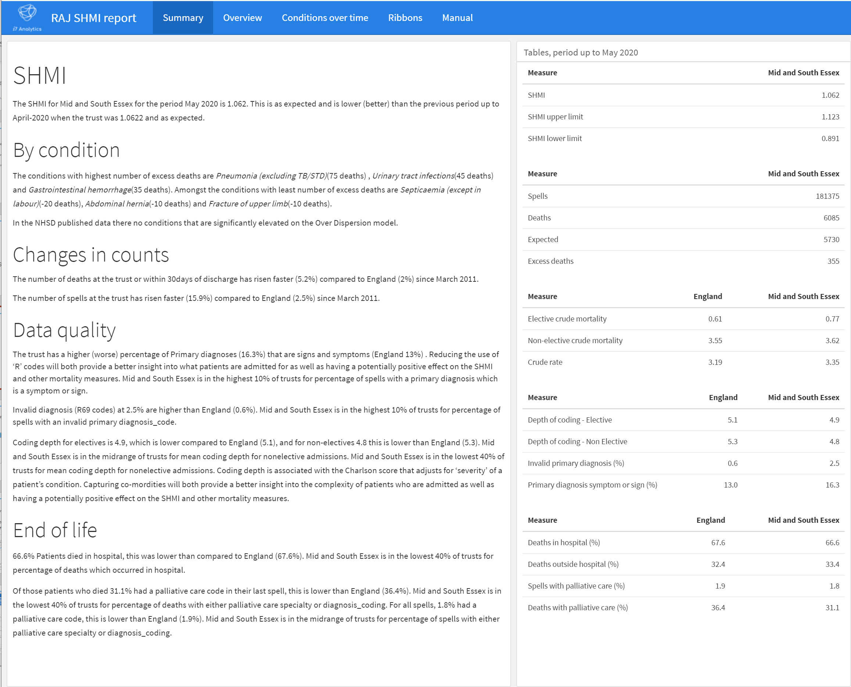
Page 1 - summary
Focus is on interpreting the changes since the last publication

Slide 27
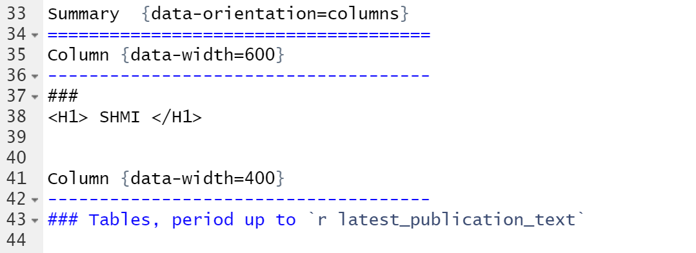
Design: Page 1 - summary
Provides an automated summary of the SHMI
Title and navigation bar
Text [width 600 pixels] | Table [width 400 pixels]

Slide 28
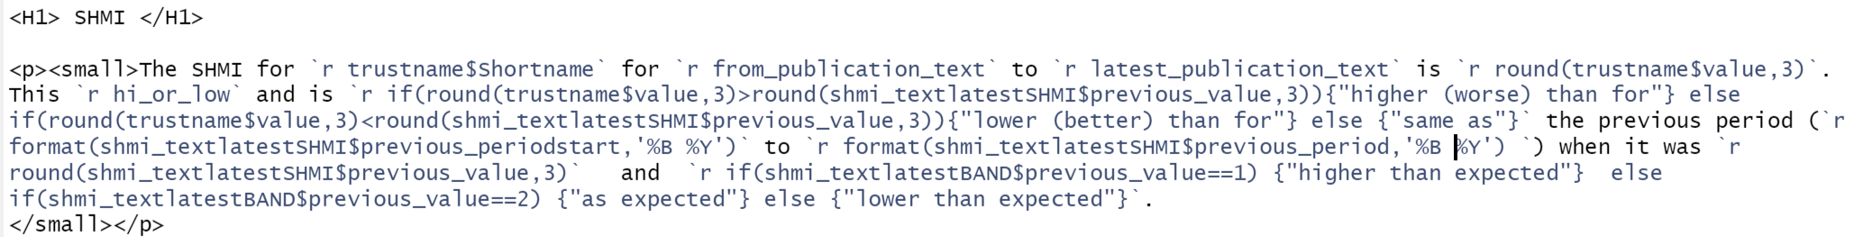

Dynamic text summary
Users often want the key messages for their reports, or to help interpret the dashboard.
This is achieved using intext R, html and a lot of if(){} else {}
Could use child documents to shorten this if it became to long
v

Slide 29
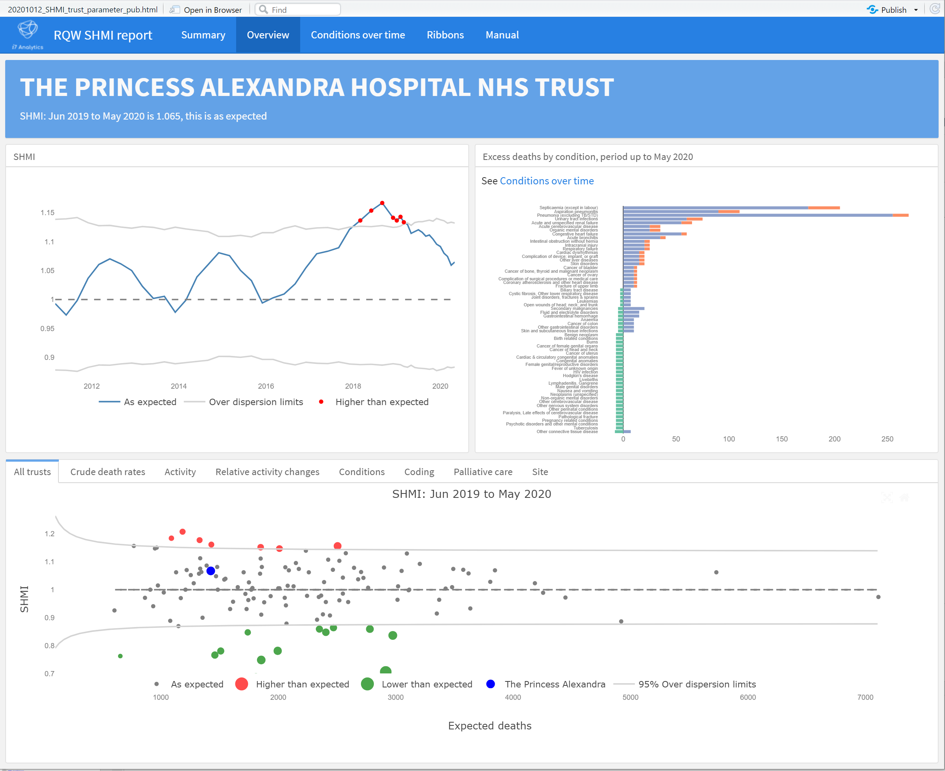

Page 2 - overview
A
The value box turns orange (warning) if the trust is an outlier.
Might replace value box as taking up too much ‘real estate’ and cannot change its size
B
C

Slide 30
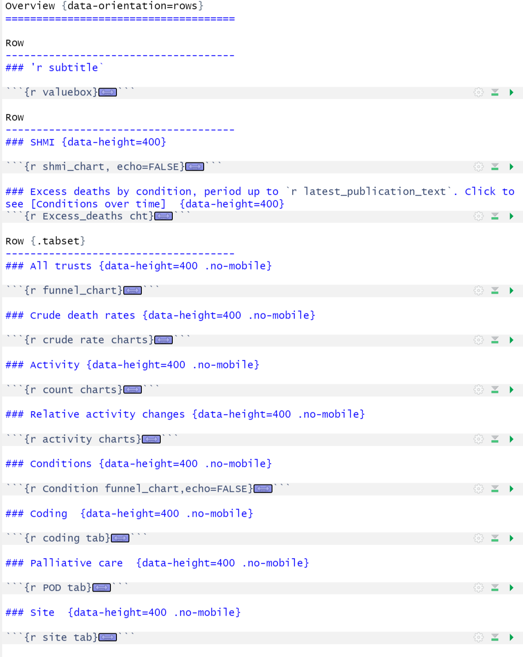

Page 2 Overview
A
B
This page uses 3 rows
Page links to Conditions over time
C
Title and navigation
Value box (headline measure) + subtitle
Head line chart |  |  |  | Head line chart
Tab | Tab | Tab | Tab | Tab | Tab | Tab | Tab
Tab window
A
B
C

Slide 31
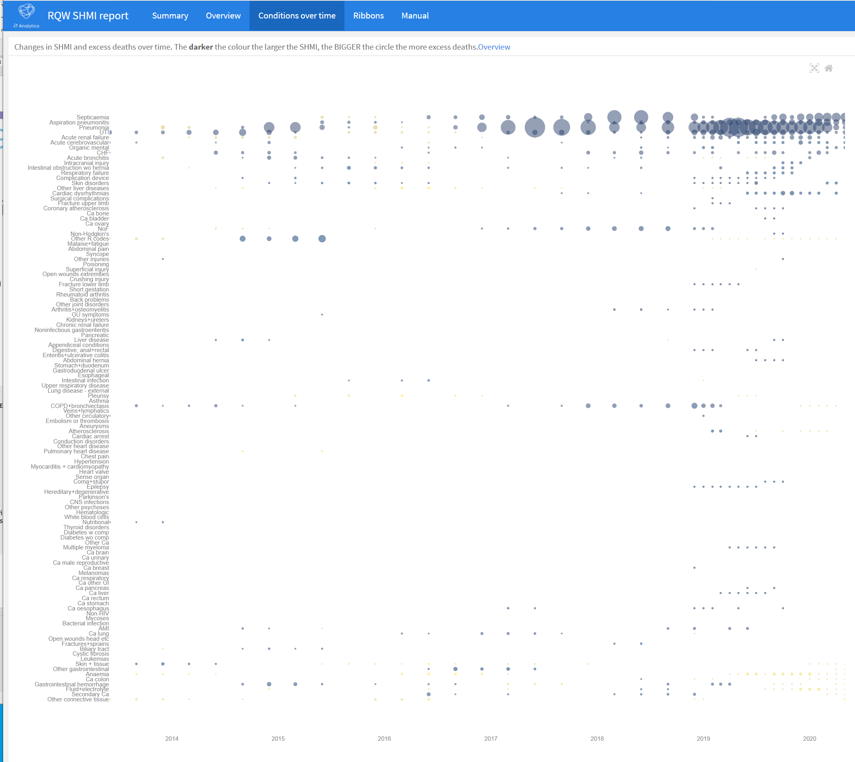
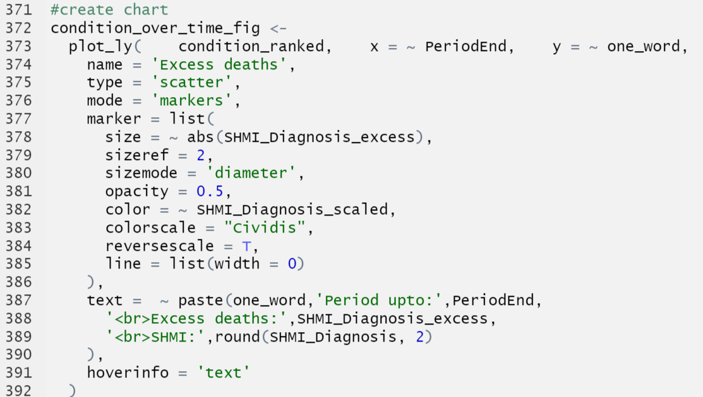
Page 3 – Change over time
This chart is quite simple to construct.
Basically a scatterplot with a factor for y axis
Marker size is scaled by the absolute number of excess deaths and colour by SHMI value scaled

Slide 32
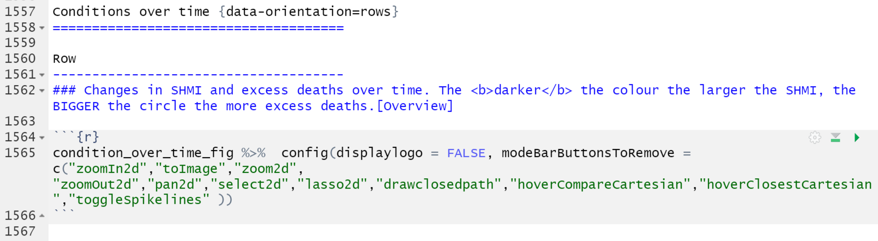


Page 3 Change over time
Page links back to overview
Title and navigation
Text
Chart 1
Plotly provides a tool bar for chart interactions. You can edit this to reflect how you want your user to explore.
In this dashboard there are limited areas to explore, hence the toolbar has been reduced to free up space and improve user experience

Slide 33
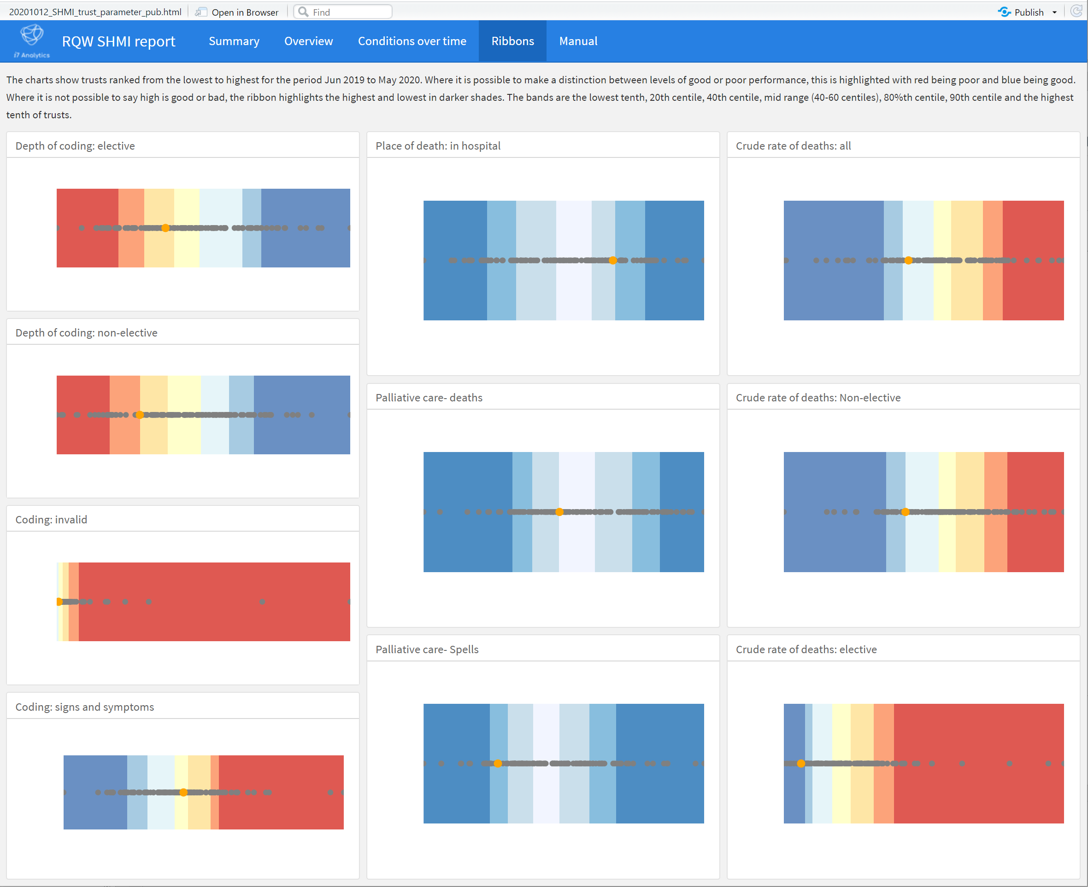
Page 4: ribbons
These are done in plotly as ggplot does not allow you to set xlimits for stacked bar.

Slide 34
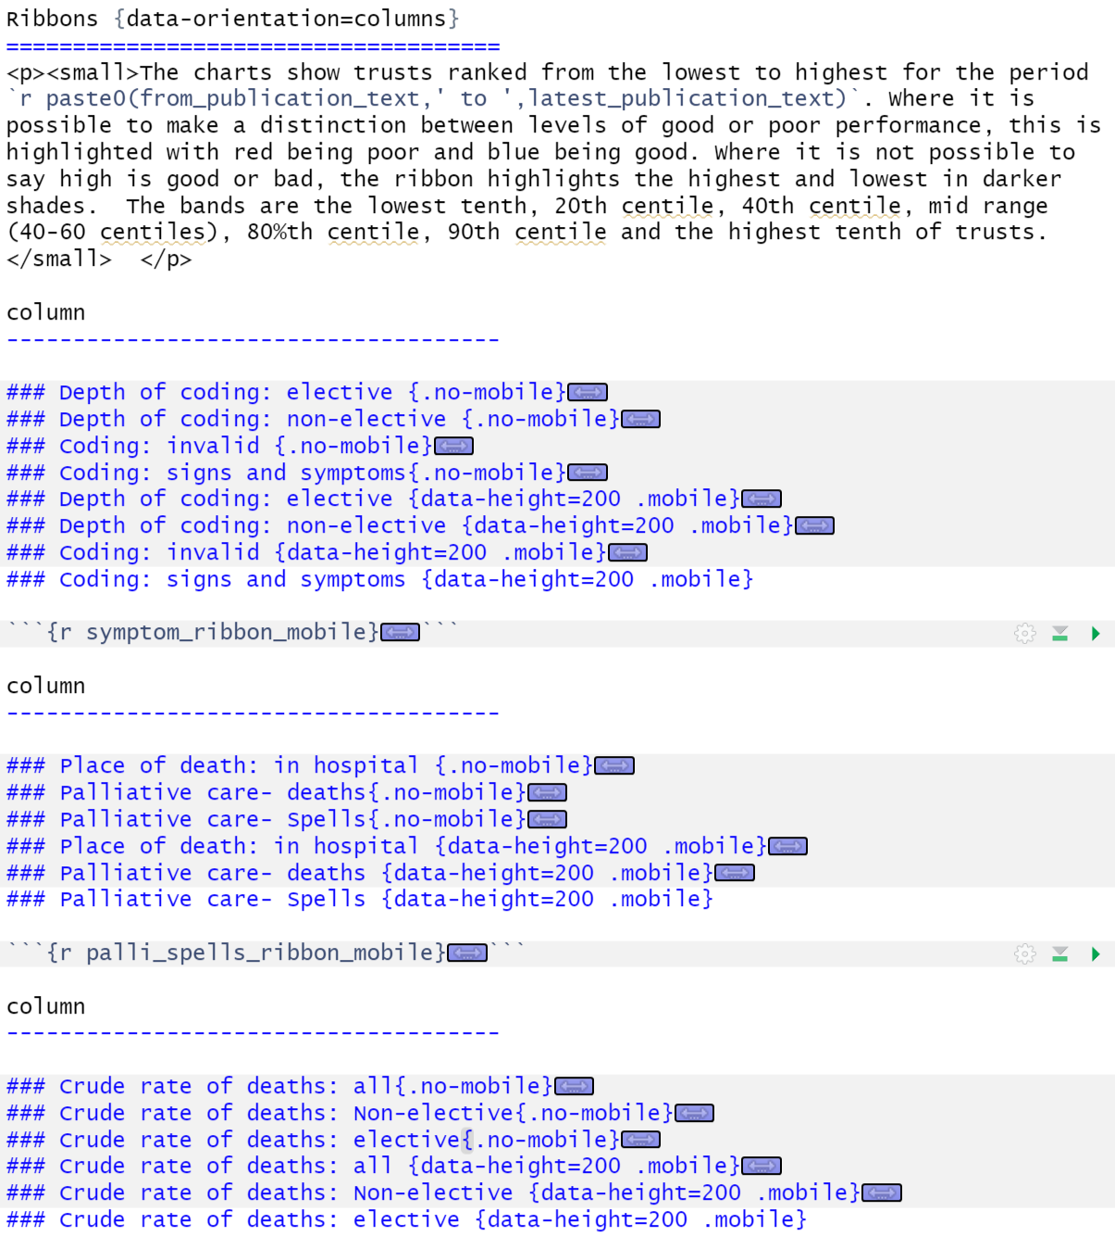
Page 4 - ribbons
Charts in this section have .mobile and .no-mobile options
Title and navigation
Text
Column1 | Column2 | Column3

Slide 35
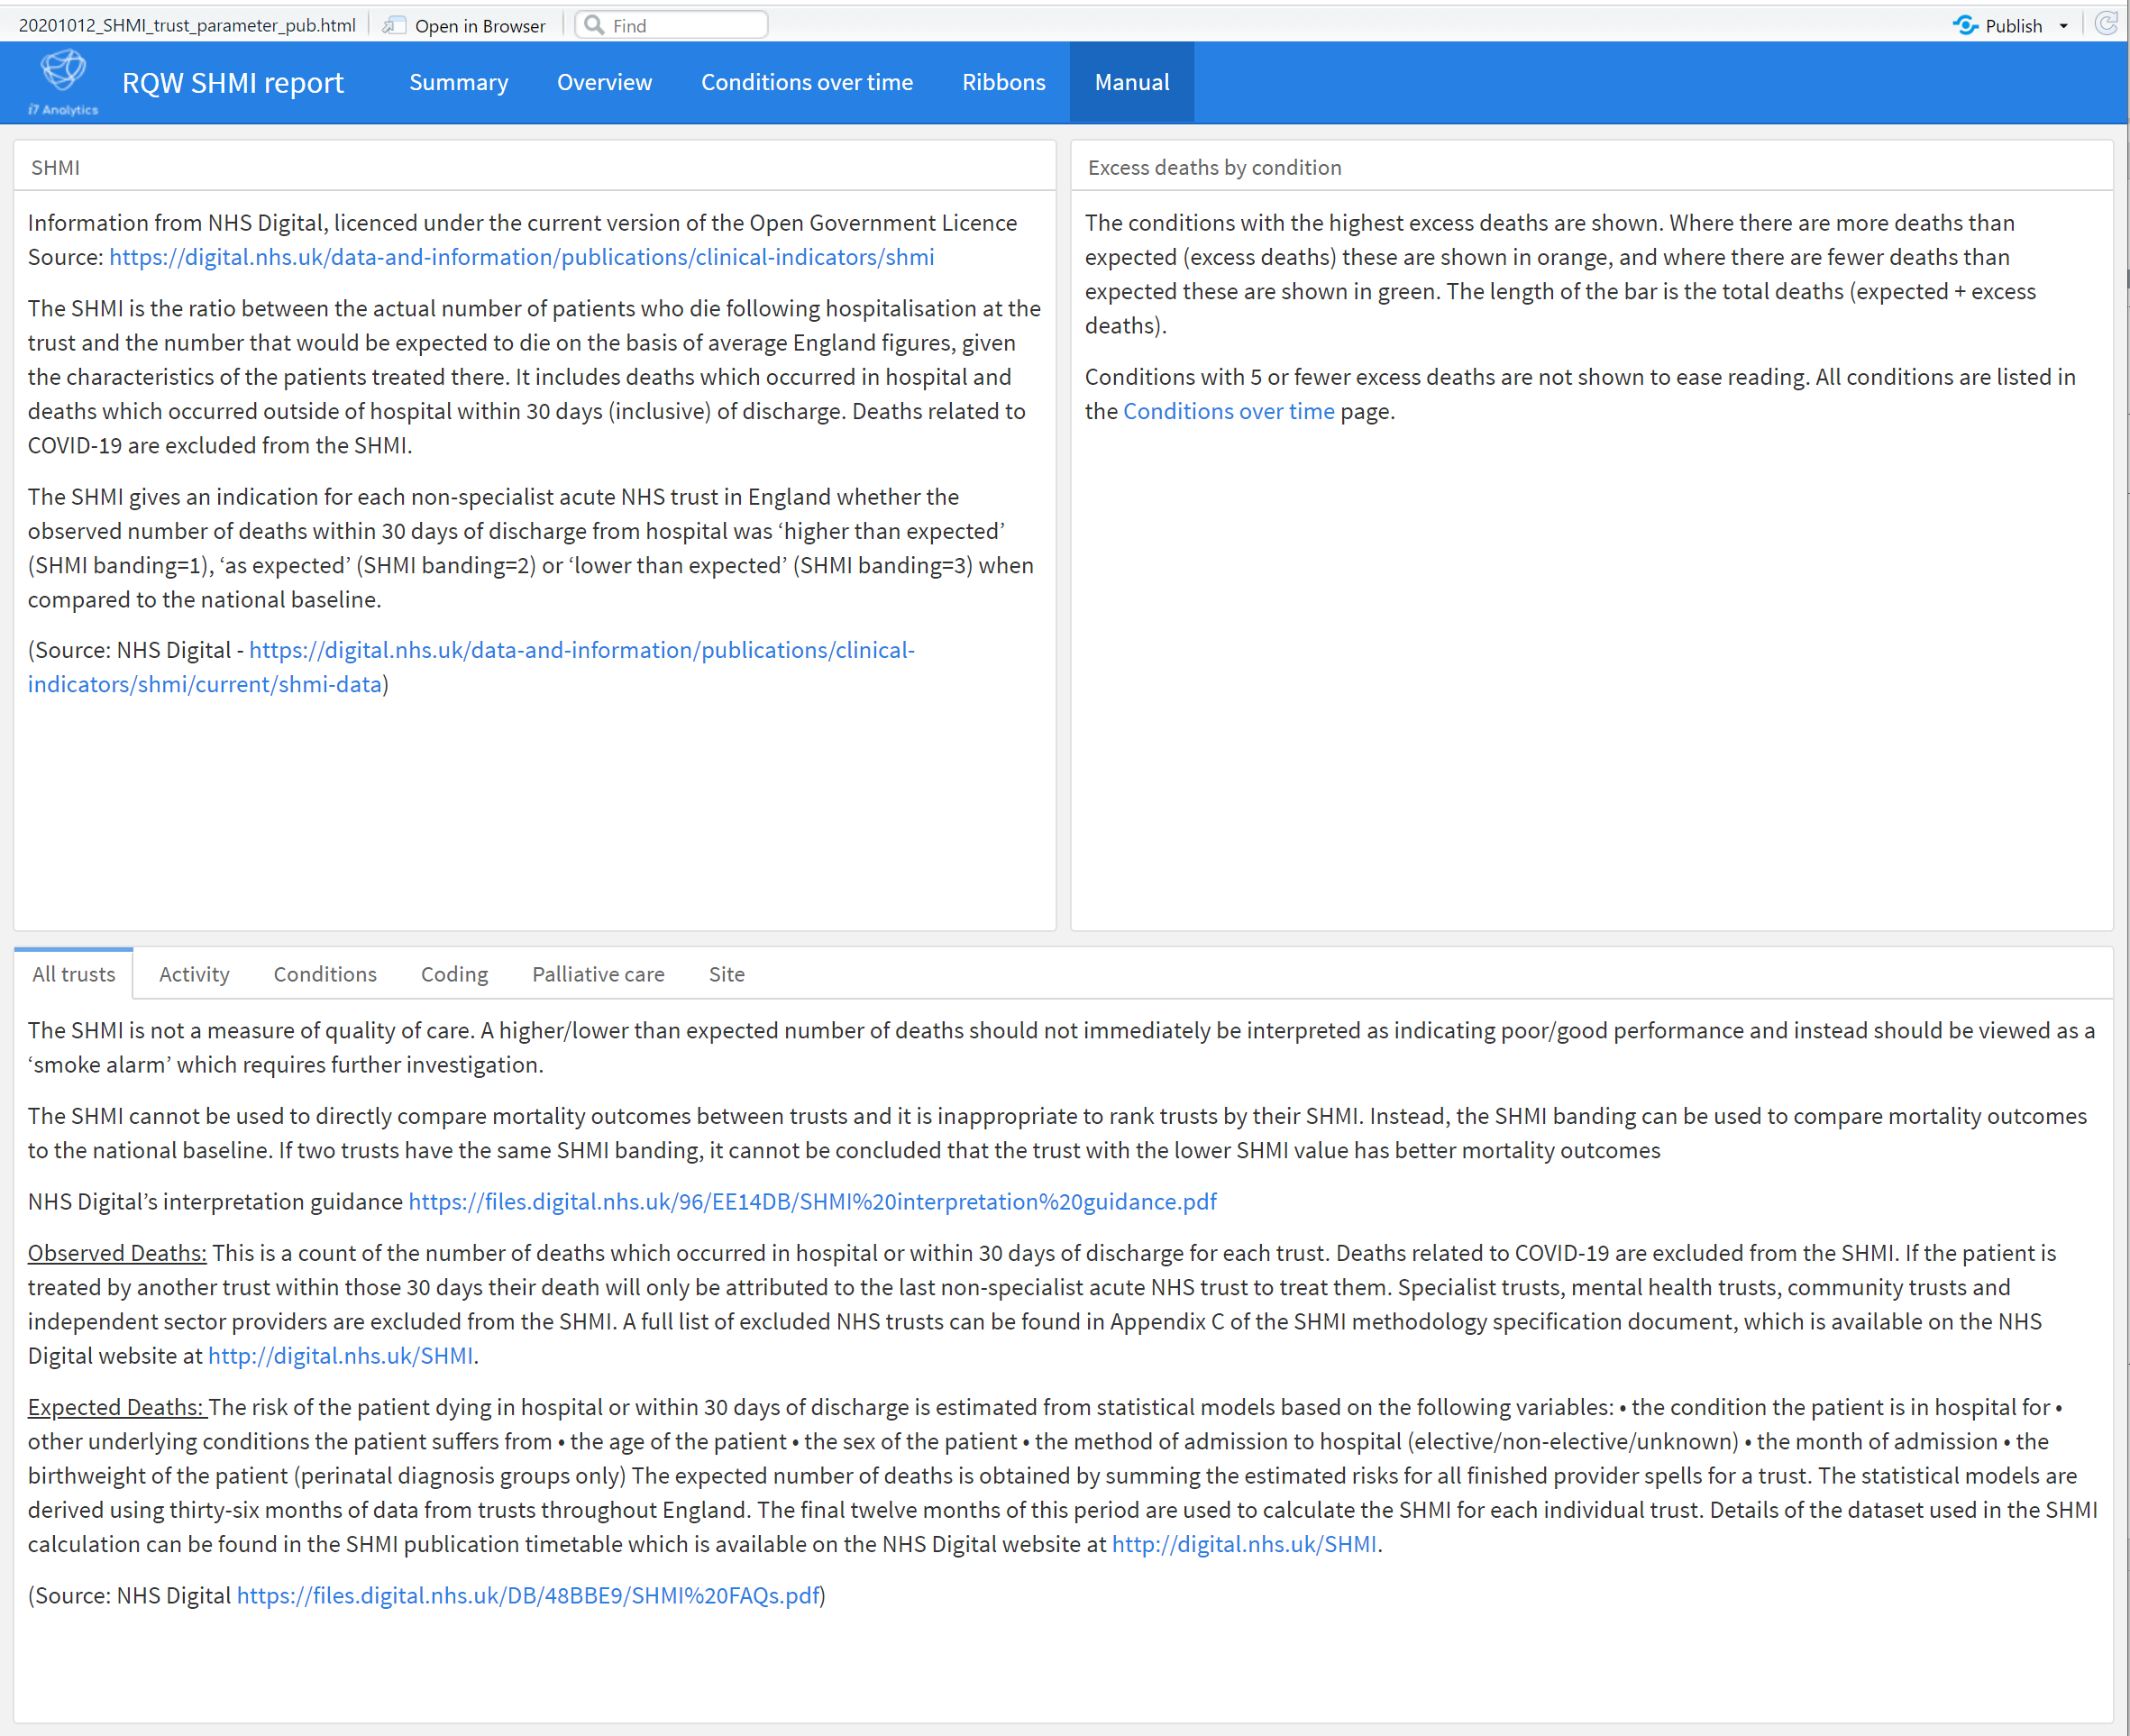
Page 5 – Help manual
Mirrors layout of page 2
Would be nice to link directly to each key element, but you can’t

Slide 36
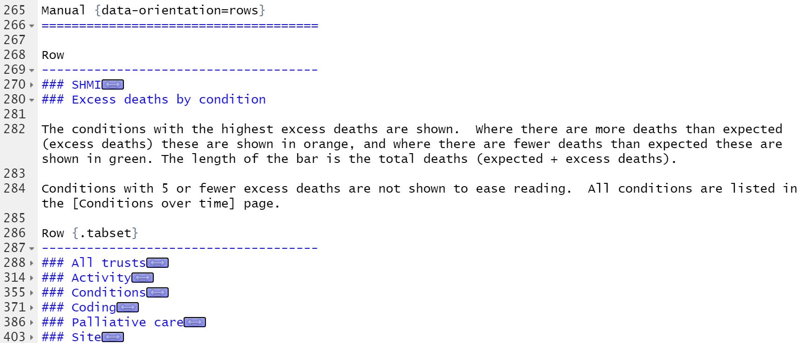
Page 5 – Help manual
Mirrors layout of page 2
Title and menu bar
Text1 |  |  |  | Text2
Tab | Tab | Tab | Tab | Tab | Tab | Tab | Tab
Tab window

Slide 37
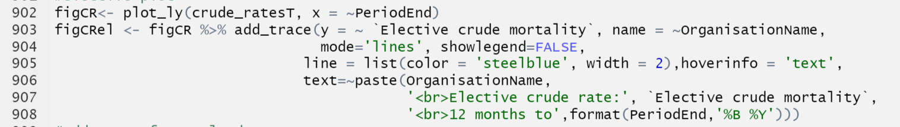
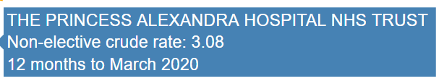
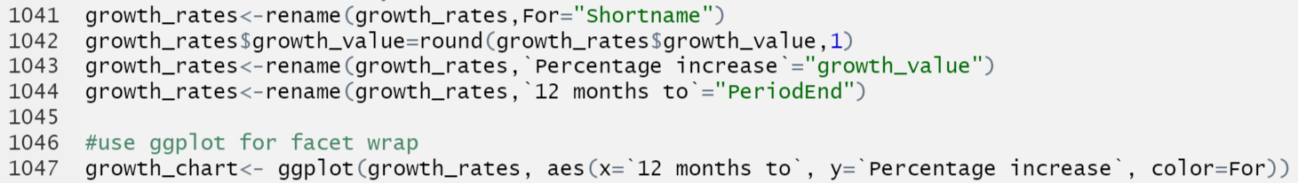
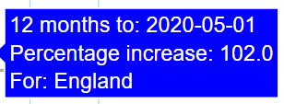
Charts: Plotly or ggplot(y)
Just found out there is also ggiraph and echarts4r
Charting options offer similar but different options
Sometimes it is just a bit easier in Plotly
Big difference is interactivity and Tooltips
Plotly lets you use html to fashion more user friendly information, even bring in variables not in the chart
ggplot rendered with ggploty limits you to the aesthetics, and presents with the variable name
Plotly
ggplot
x
y
color

Slide 38
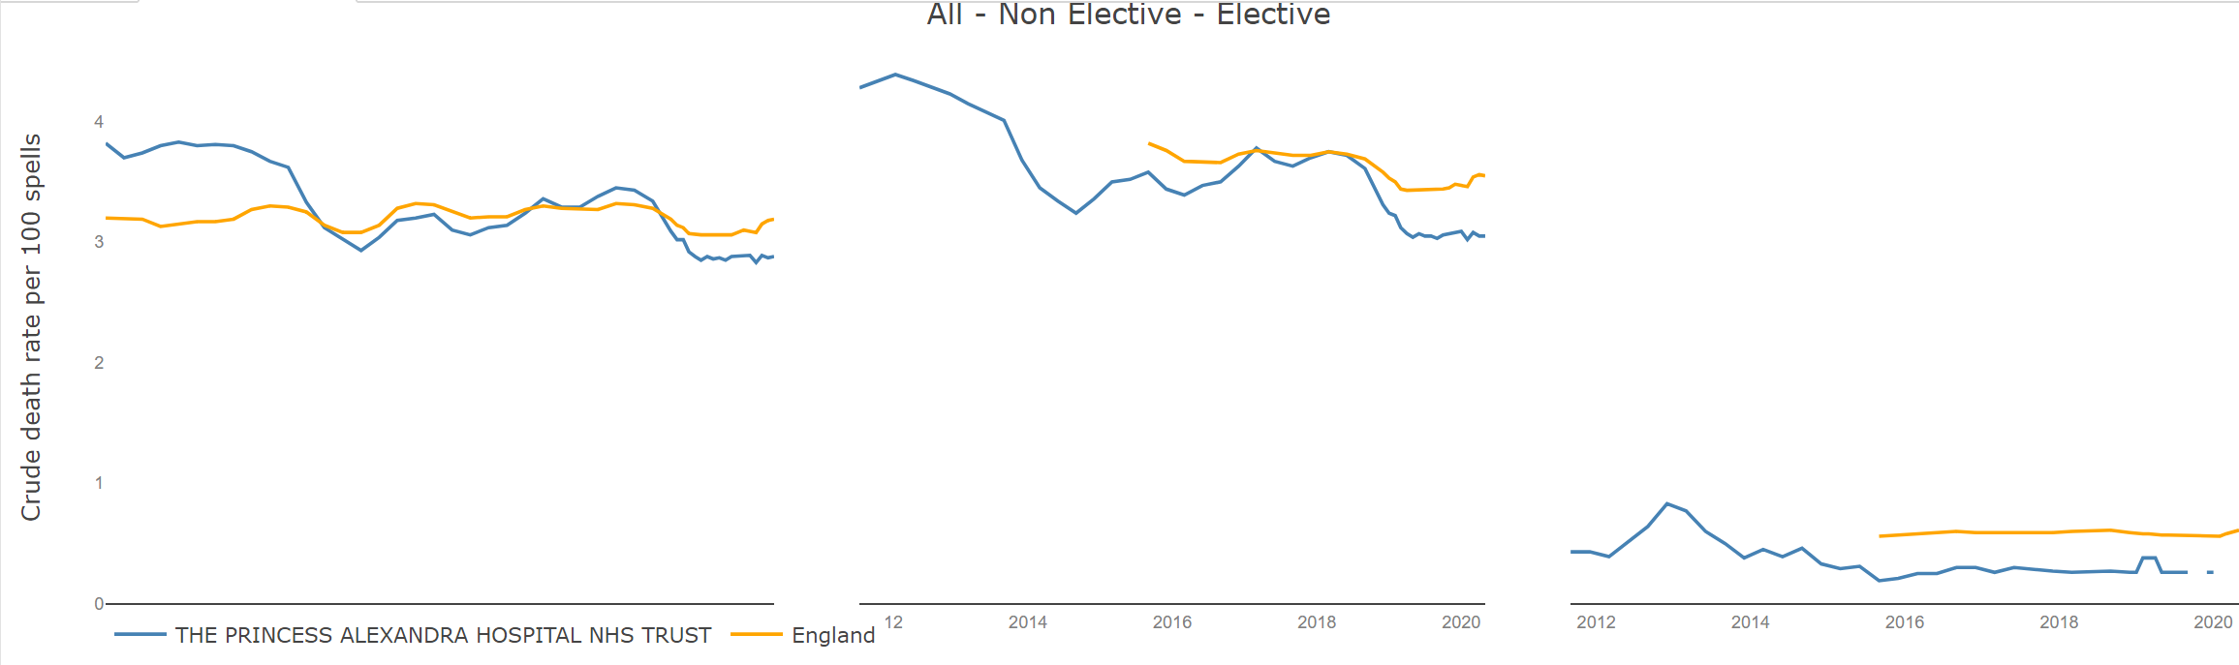
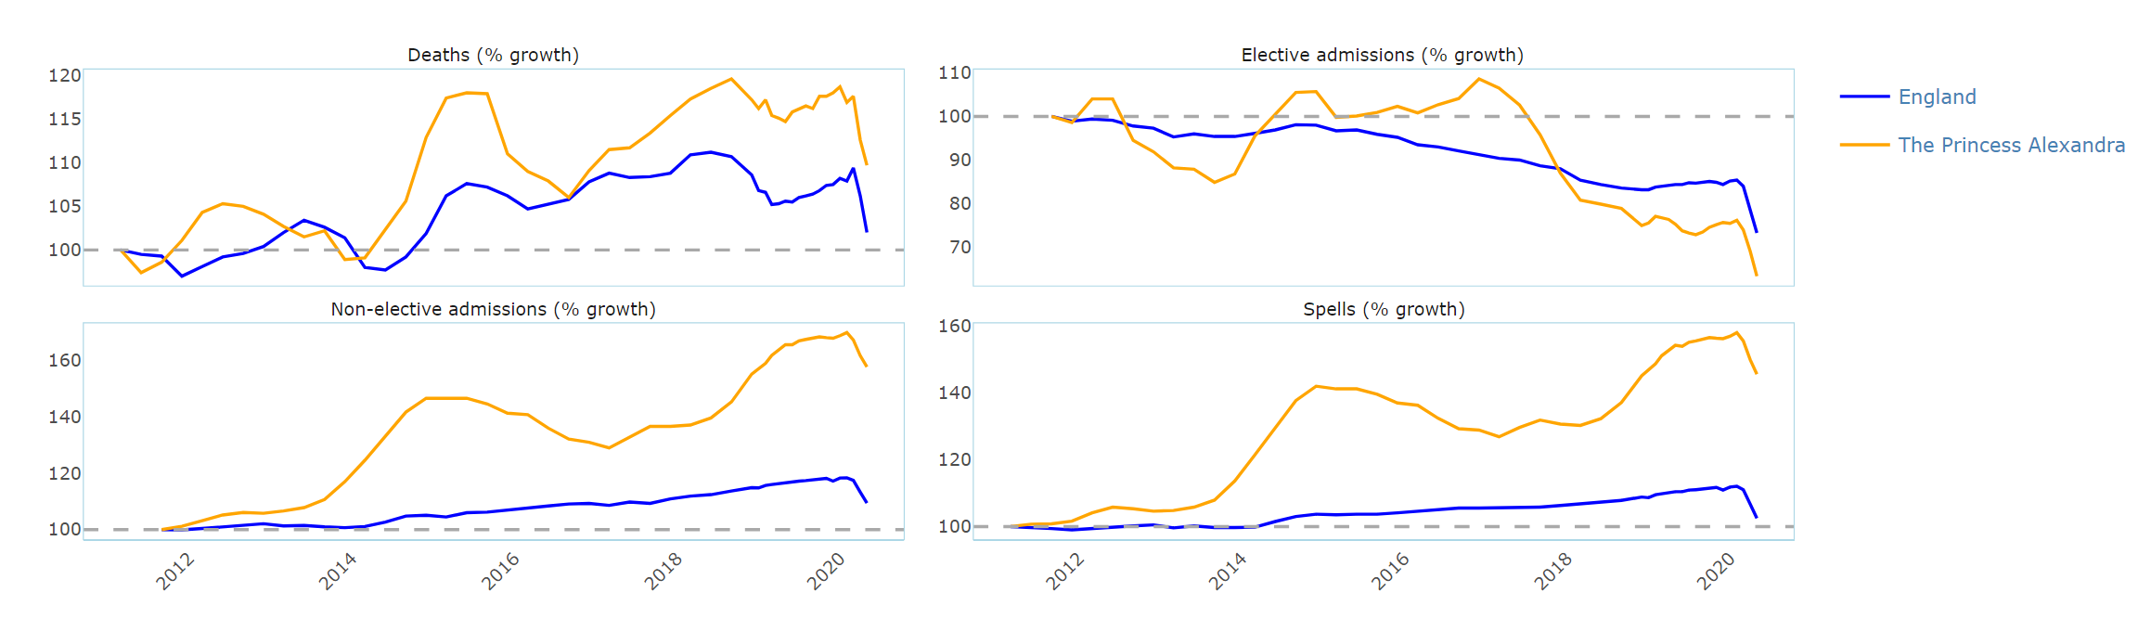
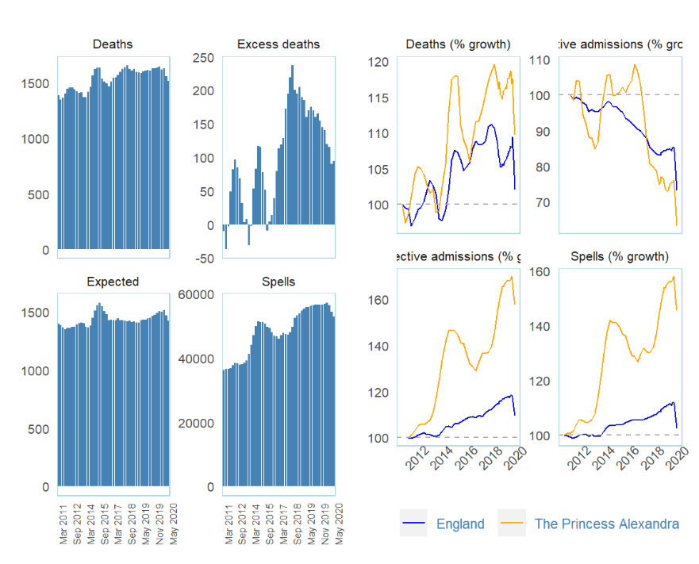
Multiple charts: subplot, FACETwrap or GRID
Subplot
Messy bit of Flexdashboard
Subplot part of plotly
No way to add title for each chart in subplot
What happened to the legend!
Facet
Legend not in right place legend_position = bottom
Grid_arrange
Charts present correctly but challenging to make them the right size.
Also cannot use tooltips nor toolbar
Facet
Grid_arrange

Slide 39
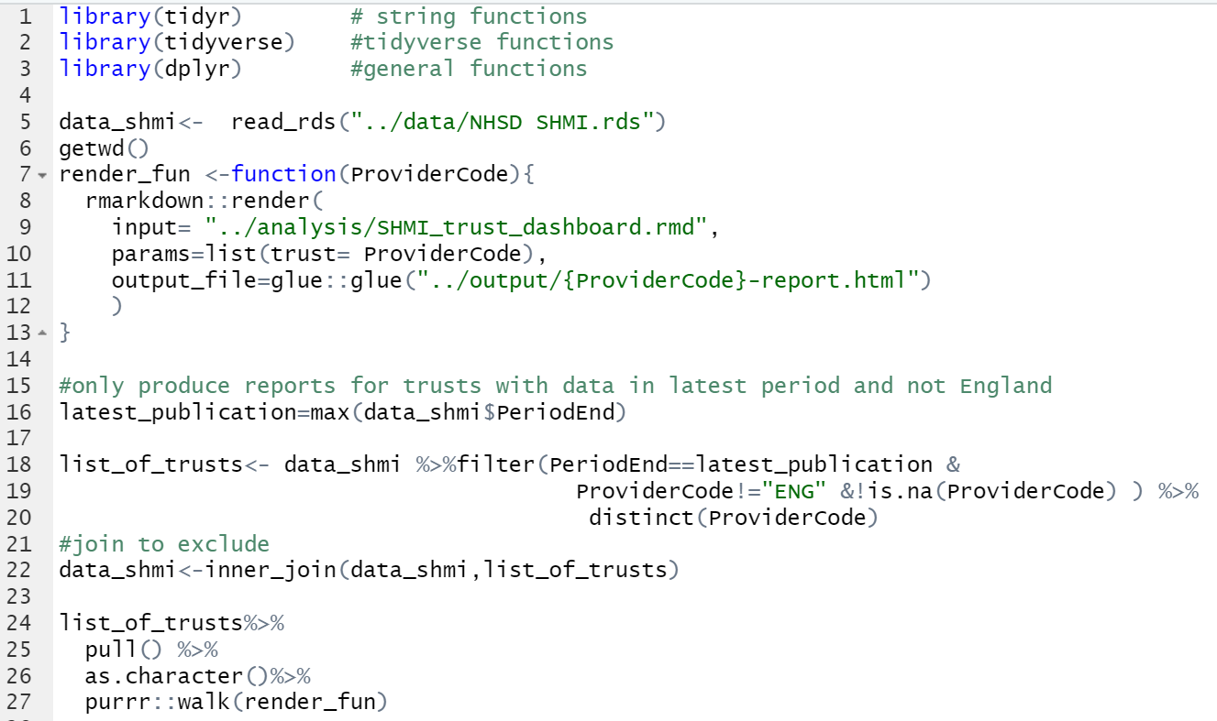
Parameterisation for deployment
Easy to then produce dashboard for every trust in the data set or a subset
Also a great way to find errors in your data set, as it will fail when it finds those missing/out of bounds values!

Slide 40
Browsers
No significant issues
Presents exactly the same for
Chrome
Edge
Safari
Tooltip on click, not hover

Slide 41
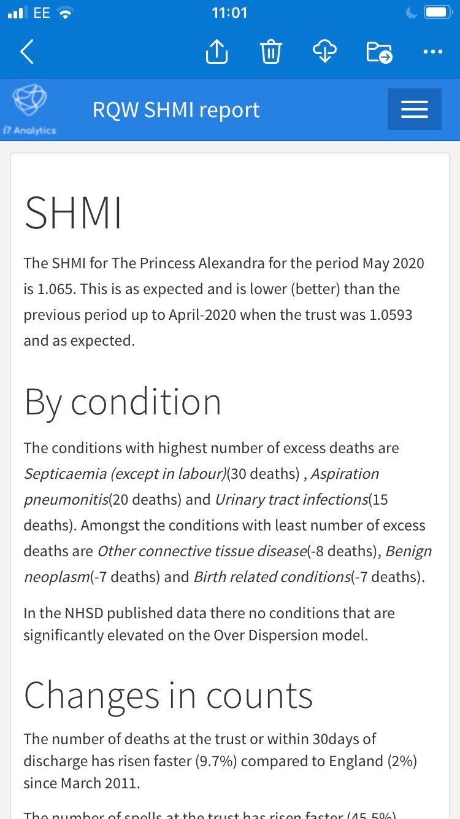
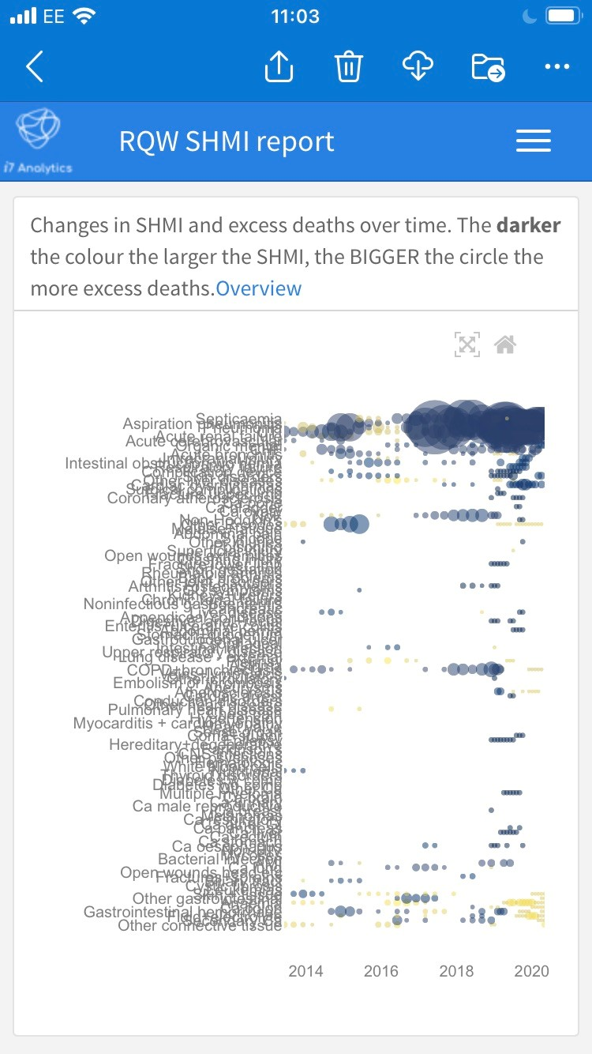
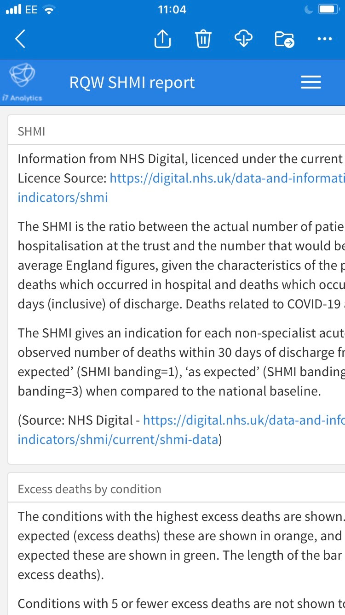
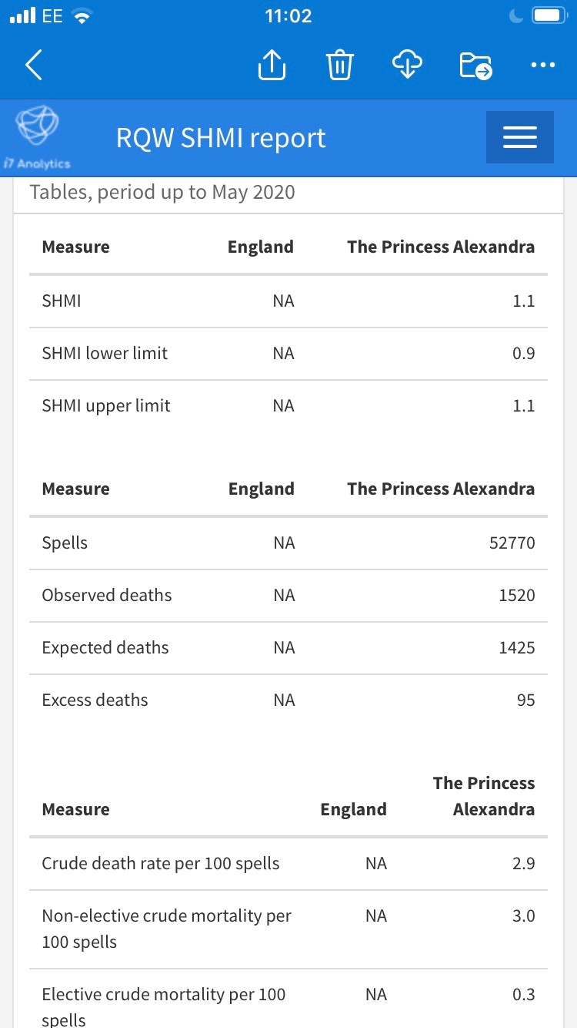
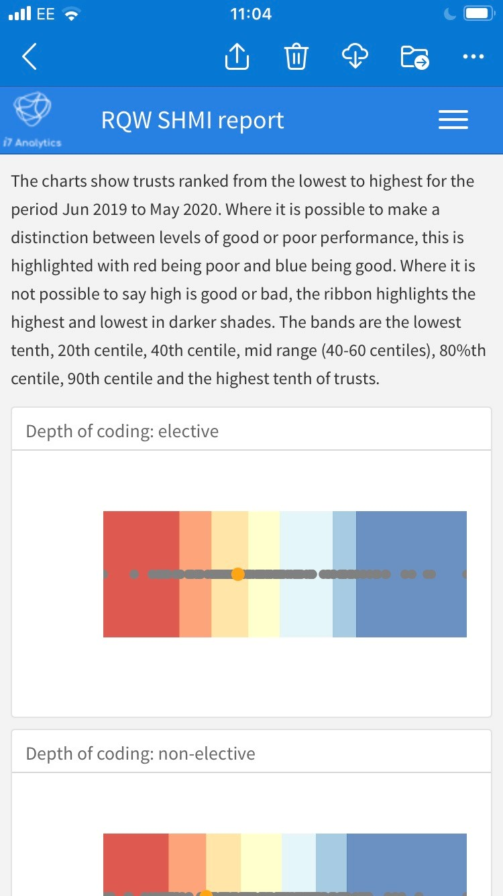
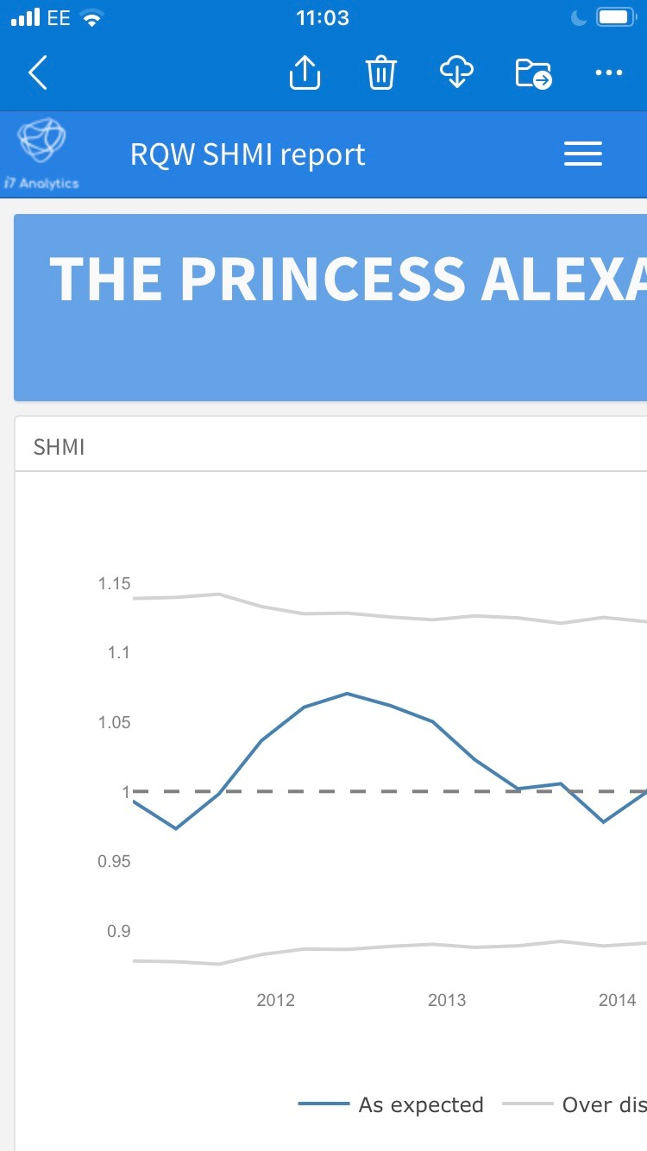
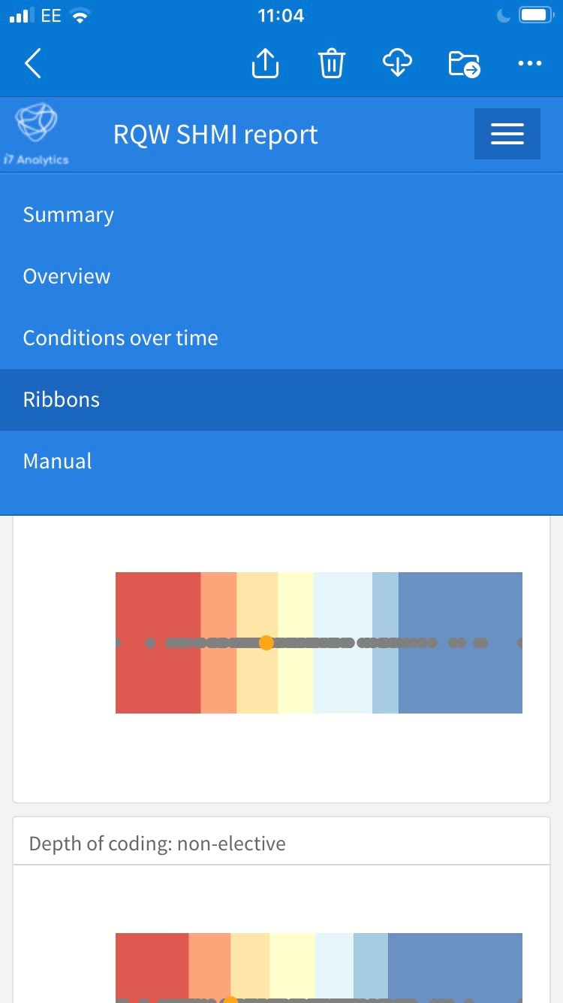
Going {.mobile}
For simple dashboards Flexdashboard will auto resize to fit screen
However if you have a complex one then you need to play around with {data-height} and {data width} and {.mobile} {.no_mobile} to format your pages
Does not like tab sets
Challenging logic and a lot of trial and error
Still not got it to work!
Tableau is easier in this regard as it has pre-defined sizes and preview

Slide 42
R
Pros
Cons
Free
Open source great for collaboration and sharing
Go from data entry-prep-present in one flow not jumping around packages
When it is good it is great, almost as good as the best in class
Funnel plots are a lot easier to create
Plenty of support to solve all those issues! Much better than for Tableau
Mass production
New and/or old skills
Had not expected to have to remember all that html
Not Desk Top Publishing quality
Not pixel perfect
Idiosyncratic the way packages respond to changes
Lots of trial and error
Not very mobile friendly (if that is important to you)
As a programming language it is never going to be forgiving when the data is not perfect
Not completely free if you want to have your own server

Slide 43
So what have I learnt
Ideal for quick dynamic dashboards, if you have already got a markdown report really easy to just drop into a flexdashboard
Now I have a working template it has been easy to create versions for different users
More rewarding than sending a slide pack!
But is it a viable corporate dashboard tool?
Is it too complex, not so much the language but the data gymnastics you have to do get the data into the format you need
Limited options, unless you want to code, I wanted to be an analyst not a web developer
Need to invest in a blend of people working in a team to operationalise, different type of person required compared to ‘point and click’ skill set required for the ‘usual suspects’
Is html a ‘secure’ file option to be emailing around? But html is web ready for easy low cost publication
Overall happy with what I am able to produce, but I think it has limitations compared to the commercial offerings, it is just not as polished

